Slide 1


The 5th Annual Agricultural Policy Conference
13th- 15th February 2019
Dodoma, Tanzania
Leveraging ASDP II-NMNAP synergy for improved food security and nutrition in Tanzania
Solomon Mkumbwa
Policy Officer - EU/FAO FIRST Tanzania
Partners:

Slide 2
Outline
Global/Africa/Tanzania food security and nutrition
Implications of agricultural policy
ASDP II and NMNAP – making agricultural growth boost economic growth, reduce poverty and improve FSN

Slide 3
Global/Regional data, SOFI 2018
Globally: 11%- 821 million undernourished,
Africa: 20.4% -257 million undernourished
Sub–Saharan Africa-(23.2%), up from 222 million in 2016 (22.4%). there are 237 million undernourished in 2017

Slide 4
Global/Africa/Tanzania- Stunting, children under 5
Globally: 22.2% - 151 million (SOFI 2017)
Africa: 30.3% - nearly 59 million (SOFI 2017)
Sub-Saharan Africa: 32.6% - just under 54 million (SOFI 2017)
Tanzania: 34% (TDHS 2015/16)

Slide 5
Majority of the hungry are Rural Small farm families
In 2011 FAO estimated that 925 million people were food insecure:
50% - smallholder farm families, surviving off marginal lands prone to natural disasters like drought or floods;
20% landless families dependent on wage-labour on farming;
10% pastoralists, artisanal fishers or forest dependent communities;
20% rural migrants in slums/shanty towns on the periphery of the biggest cities in developing countries.
(FAO SOFI 2011)

Slide 6
Child stunting per region (TDHS 2015/16)
ANAEMIA
Kagera
42%
Mara
29%
45%
Women (15-49 years)
Mwanza
39%
Simiyu
33%
Arusha
36%
Kilimanjaro 29%
Tanzania
34%
Geita
41%
Shinyanga
28%
Kigoma
38%
Manyara
36%
58%
Children (under 5 years)
Tabora
28%
Singida
29%
Kaskazini Unguja 23%
Tanga
39%
Kusini Unguja 27%
Kaskazini Pemba 34%
Katavi
39%
Dodoma37%
Mjini Magharibi 17%
Pwa-
ni
30%
Moro-
goro
33%
Kusini Pemba 24%
OBESITY+OVERWEIGHT
Iringa
42%
Dar es Salaam 15%
Mbeya
38%
Rukwa
56%
28%
Women (15-49 years)
Regional percent of children under 5 stunted, or too short for age
Njombe
49%
Lindi
35%
Ruvuma
44%
Mtwara
38%
Notes:
Regionally, stunting among children ranges from a low of 15% in Dar es Salaam to a high of 56% in Rukwa.

Slide 7
Agricultural sector .. .the sleeping giant
Poverty and malnutrition in Tanzania are mainly rural, borne disproportionately by those depending on farming, fisheries, and livestock (DfID, 2016).
Agricultural growth is 5X more at poverty reduction than other sectors

Slide 8
Why agriculture victimized? Multiple policy injections
80% of food consumed in Tanzania
65% of inputs to industrial sector
30% of export by value
29% of national GDP
70% of overall employment
90% of the rural labour force
.?.% of Voters
Considering the important roles of agriculture, the sector has been subjected to so many policies in attempts to achieve different goals, some of which are:
Good but contradictory
Overdose
Wrong diagnosis
Policy reform fatigue, malaise

Slide 9
AG POLICY FAILURE HAS DOUBLE AFFECTS ON BUDGET
Problem:
Food shortage
Cause:
Production failure due to weak access to seeds & fertilizers
Policy response:
Food import
Policy response failure:
Not addressing the cause of crop failure among smallholder producers
Result:
Entrenched poverty among the smallholder farming HHs
Problem:
Food poverty at HH
Cause:
High food price, failed income, disabilities
Policy response: None
Policy response failure:
None response
Result:
Food deprivation and malnutrition
Problem: Increased cases of malnutrition
Policy Response: Request for more budget for treatment

Slide 10
ASDP II and NMNAP
NMNAP:
“Children, adolescents, women and men in Tanzania are better nourished leading to healthier and more productive lives that contribute to economic growth and sustainable development”.
ASDP II:
“to transform the agricultural sector (crops, livestock & fisheries) towards higher productivity, commercialization level and increase smallholder farmer income for improved livelihood and guarantee food and nutrition security”.
Opportunity:
How do we enable agricultural growth to boost economic growth, food security and nutrition?

Slide 11
NMNAP Coordination System
Development Partners Group on Nutrition (DPG-N)
Members: (UN, Donors, CSOs, Business)
High Level Steering Committee on Nutrition
Chair: PS Prime Minister’s Office
Secretariat: PMO/TFNC
Members: Line ministries (PS), UN, Donors , CSOs, Business Networks
Mutisectoral Nutrition Technical Working Group
Chair: MD TFNC
Secretariat: TFNC
Members: line ministries, UN agencies, Donors, CSOs, Business (technical)
Sub-Committee to Monitor Large Scale Nutrition Program
MDAs
PO-RALG
Thematic Working Groups on:
      Maternal, infant, young child and adolescent nutrition
      Micronutrients.
      Integrated Management of Acute Malnutrition
      Prevention and Management of Diet Related Non-Communicable Diseases
      Nutrition Sensitive interventions.
      Multisectoral nutrition governance
      Multisectoral nutrition information systems
      Resource mobilization
Regional Steering Committee on Nutrition
Council Steering Committee on Nutrition
LGAs Structures
CSOs (NGOs, CBOs, FBOs)
Private Sector Actors
COMMUNITY
Notes:
High level Steering Committee on Nutrition, chaired by PMO, PS from all nutrition-relevant line ministries, civil society and private sector
Council Steering Committees on Nutrition –responsible for coordinating multi-sectoral responses at district level
Multi-sector Nutrition Technical Working Group - currently poor representation from key line ministries and poorly organized
Poor coordination between nutrition coordination structures and those in the agriculture and other sectors
TFNC recognized as having a role in coordination, but perceived as performing ineffectively in this role.

Slide 12
STRUCTURE OF ASDP II
President’s Office for Regional and Local Government (PORALG)
PS-Ministry of Agriculture
National Agricultural Sector Stakeholders Meeting (NASSM)
Implementation arm of the gov’t
Reviews and budgets District Agriculture Development Plans (DADPs)
Led by PMO; Sec: NACOTE
Review implementation progress
Advisory to stakeholders
Corrective action guidance
National Coordination and Management Team (NACOTE)
Regional Secretariat
Agricultural Steering Committee (ASC)
Agricultural Sector Consultative Group Meeting (ASCG)
NACOTE will be led by the National Programme Coordinator
Team includes recruits from the labor market and from lead ministries with professional management and coordination capabilities
Planning
Reports to PS of MALF on management and administration
Serves as secretariat for NASSM, ASC, and TCD, including coordinating the preparation of workplans and budgets with TCD
Close communication with TWG
Implementation
Reports to TCD on program implementation
Coordinates with PORALG, ASDP Regional Coordinator and District Facilitation Teams
Assistant Administrative Secretary for Economics and Production, with support from Regional ASDP Coordinator support planning and provide technical advice
Led by Minister of Agriculture; Sec: NACOTE and DPP
Approves annual workplan and budget
Track financial progress and audit results
Discuss key agriculture issues
Led by PS - ASLMs; Sec: NACOTE and DPP
Provide consultative and advisory forum for dialogue between Government, DPs, Private sector, Non-state actors in agriculture sector
Council Management Team
Technical Committee of Directors (TCD)
DADPs are formulated based on VADPS by District Irrigation and Cooperative Officers and/or District Livestock and Fisheries Officers
Led by PS of MoA; Sec: NACOTE
Government only participation
Advices on technical issues
Develop and implement policy
Prepares workplans and budgets
Ward Development Committee
Technical Working Groups (TWG)
Led by Ward Councilor
VADPs (~3-6) collected by Ward Agricultural Extension Officer
VADPs submitted to DED
The current coordination framework ensures the proactive engagement of development partners, private sector, NGOs/CBOs players in planning and implementation of ASDP II
Flexible membership, size and purpose (meets monthly)
Provide technical and managerial advice to TCD and LGAs
Chairs of AWG and PSD are represented on the Agricultural Steering Committee
Dispatch national facilitation teams for project problem solving
Component Working Groups
DPs Agriculture Working Group
Village Planning Committees
DPs Private Sector Development
Village Agriculture Development Plans (VADP) are developed by Village Agricultural Extension Officers & Village Executive Officer
TWGs provide technical and managerial support to LGAs via District Value Chain Components (DVC), a group of public and private stakeholders
M&E and P & B Working Groups

Slide 13
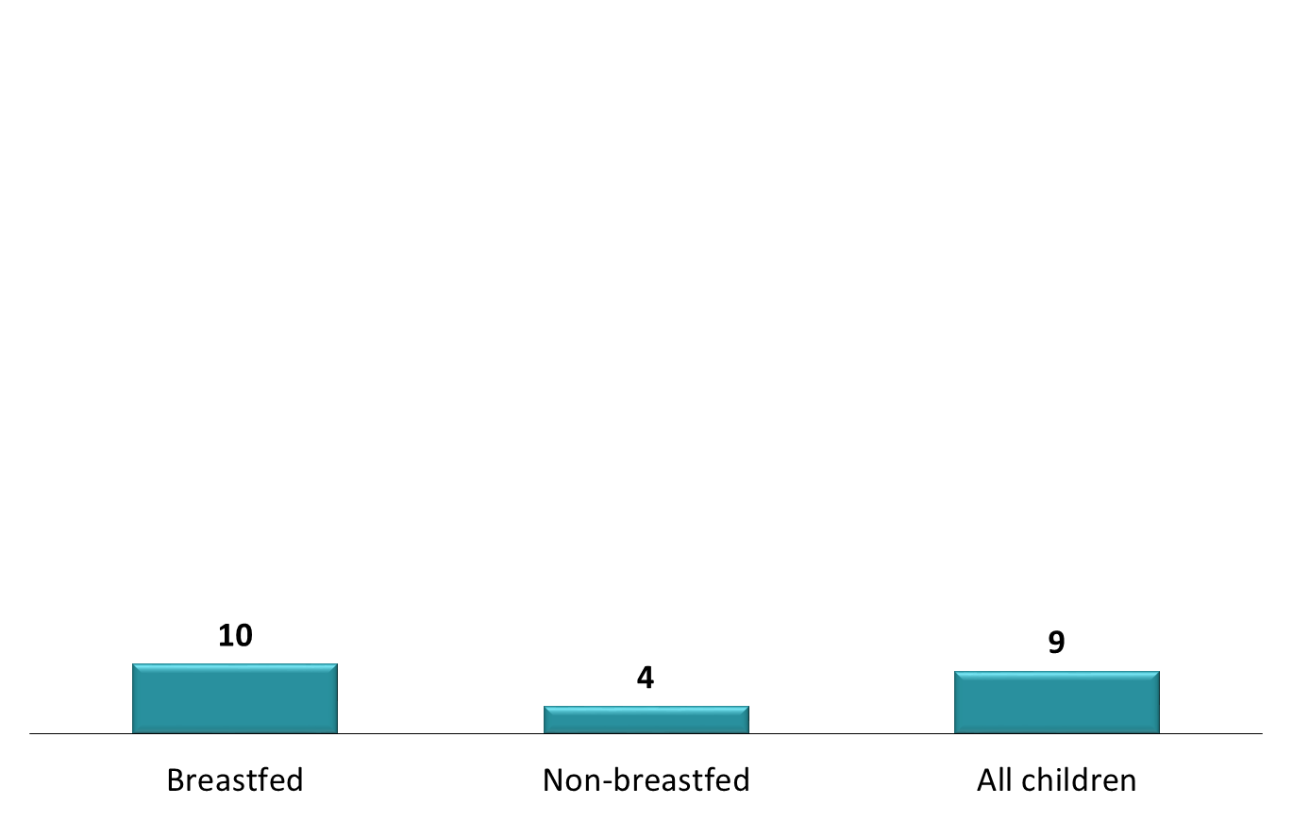
Are diversified food produced? Marketed? Eaten?
The IYCF recommendations by WHO:
  Breastfed children 6 to 23 months should receive 4 or more food groups daily and minimum 2-4 meals per day depending on age group.
  Non-breastfed children 6 to 23 months should receive milk or milk products, in addition to 4 or more food groups, and minimum 2-4 meals per day depending on age group.
TDHS 2015/16

Slide 14
ASDP II and NMNAP Should Talk
Agriculture and Food Security is mentioned as one outcome of the NMNAP, and promote diversification with projects related to: bio-fortification, kitchen gardens, small livestock, etc However, these are often not aligned to expenditure priorities in ASDP II, where the focus is mainly on staples and commercial crops
Similarly, low dietary diversification has often been highlighted in most nutrition surveys as being a huge challenge BUT no action plan has so far been put in place, with indicators and targets for tracking dietary diversification within NMNAP, and for tracking production and marketing of diversified food production in ASDP.
The dialogue between ASDP II and NMNAP will promote understanding on how determine their respective priorities; identify gaps to be filled; and identify opportunities for better linkage and coherence.

Slide 15
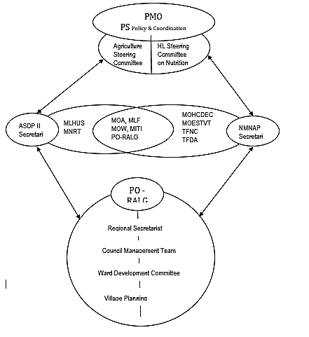
ASDP II & NMNAP Coordination
Linkages at HL, TL, OL
Intra-ministerial platform share notes
ASDP II Should attend the NMNAP Thematic Groups related to AGR.
The chair of the NMNAP –A-FNS TWG should attend the ASDP II TWG
Harmonized indicators & reporting
Integrate food security indicators:
Food production diversity (ASDP II)
Marketed food diversity (ASDP II)
Dietary diversity (NMNAP)

Slide 16
Are these feasible?

